Slide 1

Shopping Behavior Analysis
Unlocking Insights Through Data and AI

Slide 2
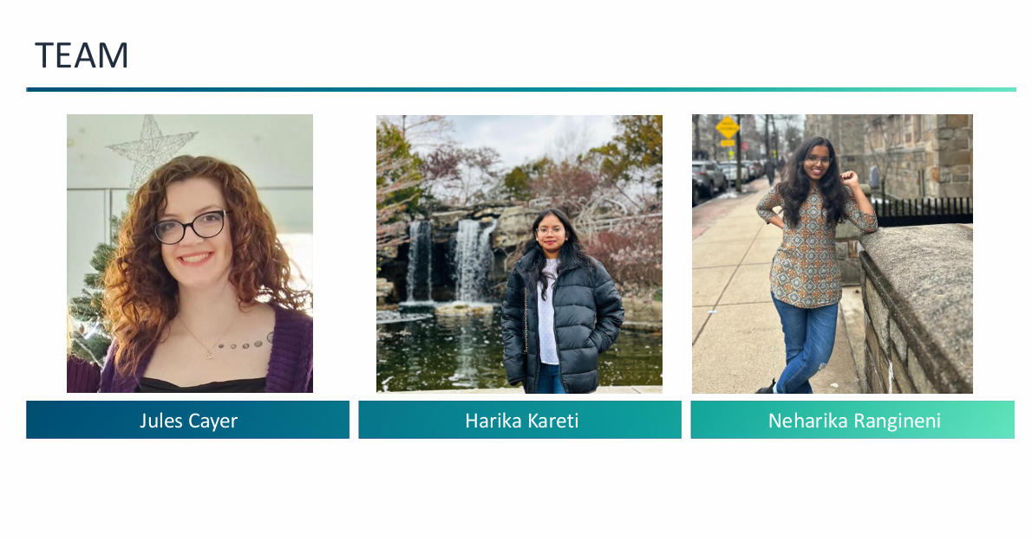

Slide 3

Table of Contents
Introduction
Dataset Overview
Data Preparation
Analysis Highlights
Model Implementation
Visualization Examples
Key Insights
Business Applications
Conclusion

Slide 4


Introduction
Problem Statement
Retailers struggle to decode customer shopping patterns, optimize inventory, and personalize campaigns, leading to lost revenue and satisfaction gaps.
Objective
Use data and AI to:
Analyze shopping trends.
Provide actionable insights for recommendations and strategic decisions.
Enhance customer experience through data-driven strategies.

Slide 5
Dataset Overview
Datasets Used
Shopping Behavior Data: Customer demographics and purchase history (items, categories, colors, sizes).
Shopping Trends Data: Seasonal trends and key product features (categories, colors).
Key Metrics
Purchase Counts: Total and product-specific purchases.
Seasonal Preferences: Popular items by season.
Gender Distribution: Shopping patterns by gender.

Slide 6

Problem
E-commerce businesses struggle to:
Provide personalized product recommendations.
Forecast seasonal trends for inventory and marketing.
Understand demographic-driven shopping behavior.
Integrate data from different sources for actionable insights.

Slide 7
Solution
This project addresses these challenges by:
Personalized Recommendations: Using collaborative filtering to offer tailored product suggestions.
Seasonal Forecasting: Predicting product demand based on seasonal trends.
Demographic Insights: Analyzing customer demographics to optimize marketing and inventory.
Data Integration: Merging and cleaning data from various sources for unified insights.
Interactive Dashboards: Visualizing data using R Studio for real-time decision-making.

Slide 8

Data Preparation
Data Cleaning Steps
Merged shopping behavior and trends datasets.
Handled missing values (e.g., using imputation).
Created new features (e.g., "Product Features" from category, color, size, and season).
Tools Used
R packages: dplyr and tidyr for data manipulation and cleaning.

Slide 9
Analysis Highlights
Customer Distribution by Gender
Visualized the gender distribution in customer purchases through a pie chart.
Category-Wise Purchases
Analyzed purchases across product categories, highlighting trends and preferences.
Purchase Frequency
Examined how often customers make purchases and the overall shopping behavior.

Slide 10
Model Implementation
Collaborative Filtering Approach
Used user-item interaction data to recommend products based on similar customer behaviors.
Model Training and Evaluation
Trained the model using User-Based Collaborative Filtering (UBCF) method.
Evaluated model performance using RMSE and precision-recall metrics.
Results
Provided actionable insights on the best-performing models.
Used metrics like RMSE for error measurement and precision-recall for recommendation quality.

Slide 11
Visualization Examples
Sample visualizations include:
• Bar charts for popular and category-wise purchases.
• Pie chart for gender distribution.
• Precision-recall tradeoff curves.

Slide 12
Key Insights
Highlights from the analysis include:
• Seasonal trends drive category-specific sales.
• Gender-specific preferences inform targeted marketing.
• Popular items enable opportunities for bundling.

Slide 13

Business Applications
Applications derived from insights:
• Personalized recommendations for enhanced customer experience.
• Inventory planning aligned with trends and preferences.
• Targeted marketing campaigns using demographic insights.

Slide 14
Conclusion
This project demonstrated the power of AI in retail analysis.
• Summarized key insights and applications.
• Future directions: Real-time data integration and advanced models.

Slide 15
Thankyou

